Slide 1
Mantid Release Presentation
Release 3.3
ISIS

Slide 2
What is this meeting
Release 3.3
Released on Monday 19th January
Present the changes and improvements
Focus on Autoreduction
What’s coming next

Slide 3
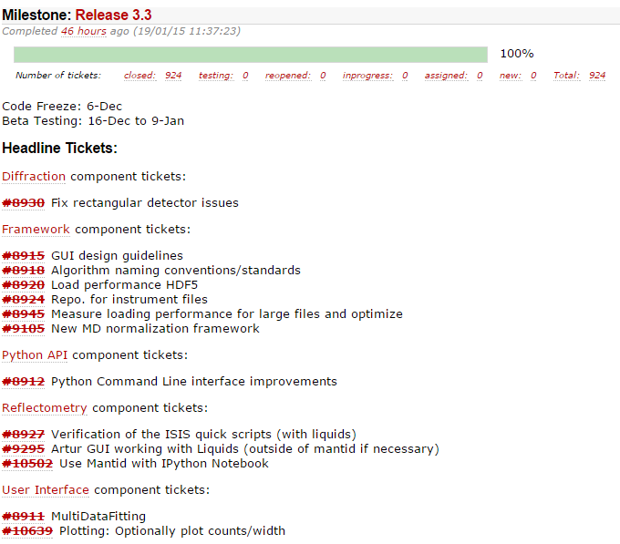
The Mantid Roadmap

Slide 4
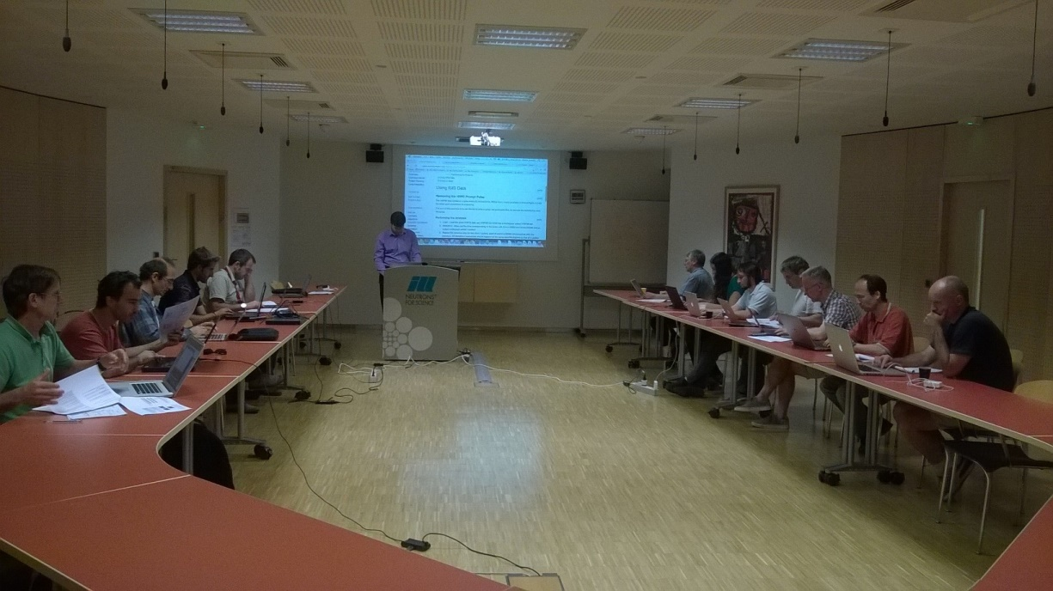
Training Courses
Dates
Neutron Training Course
Should we offer another run before startup?
To Book
Email: nick.draper@stfc.ac.uk
More details at www.mantidproject.org

Slide 5







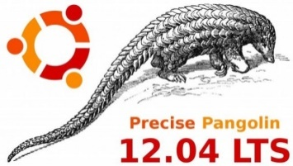
Supported Platforms
Staying the same
RHEL 6 64bit
OSX Mountain Lion +
Windows 7 64 bit
Ubuntu 14.04 64 bit
Limited support for
Windows 8 64 bit
Fedora 20
RHEL 7 64bit
No Longer supported
Ubuntu 12.04 64 bit

Slide 6
User Interface

Slide 7
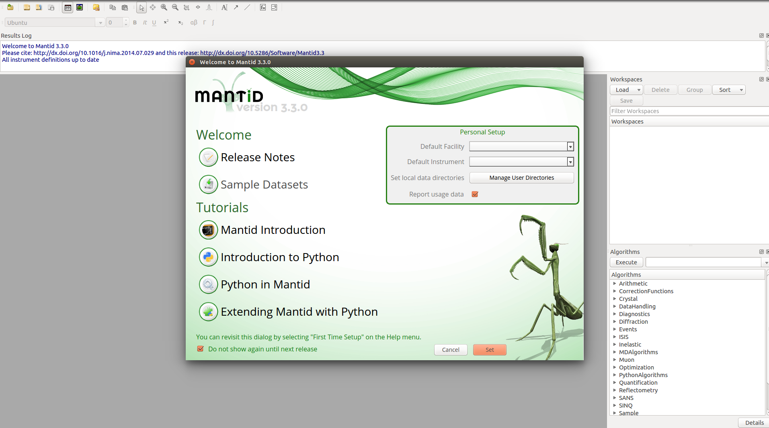

Artwork & Startup
New artwork provided by ORNL graphics team

Slide 8
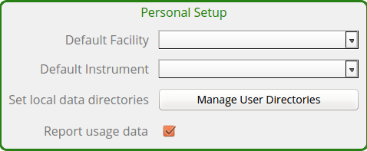
Artwork & Startup
New artwork provided by ORNL graphics team

Slide 9
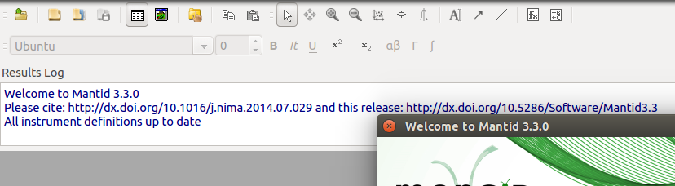
Artwork & Startup
New artwork provided by ORNL graphics team

Slide 10
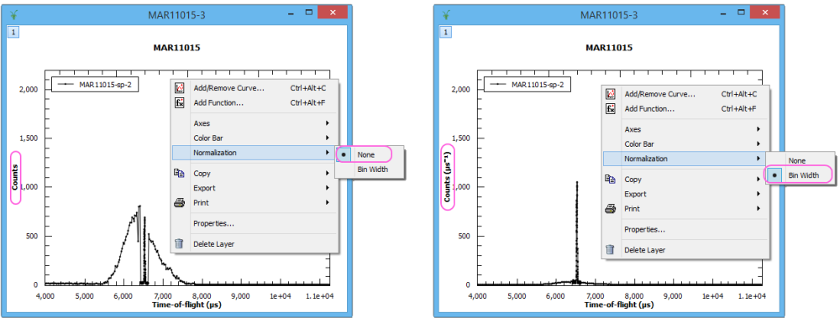
Histogram Plots
Histogram plots are now normalised to bin width by default
Data is not altered

Slide 11
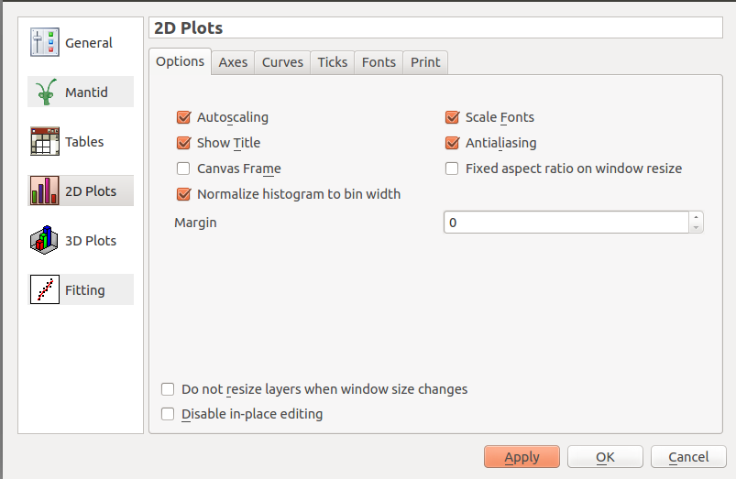
Histogram Plots
Histogram plots are now normalised to bin width by default

Slide 12
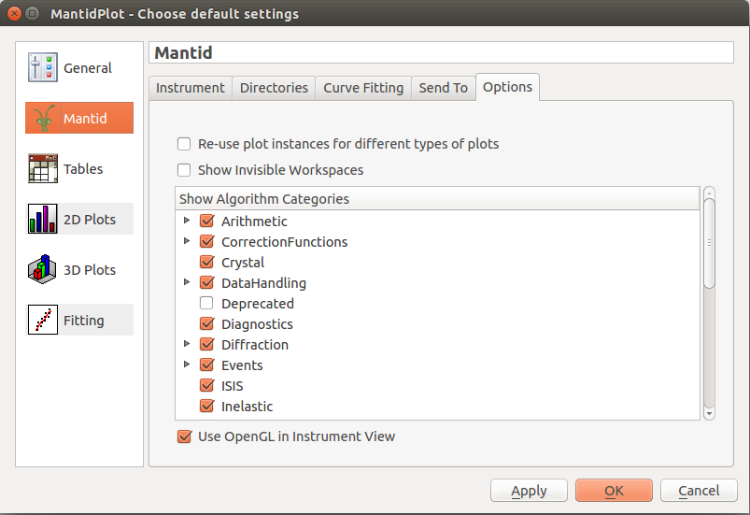
General Plot Options

Slide 13
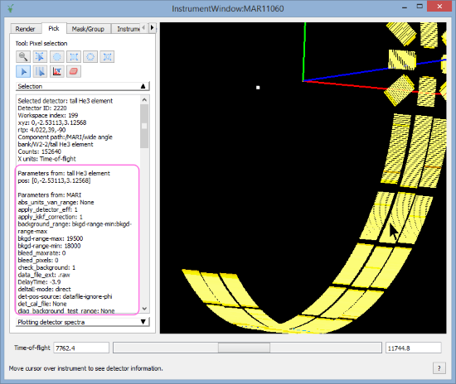
Instruments
Instrument parameters are displayed in pick mode
SaveParameterFile algorithm

Slide 14
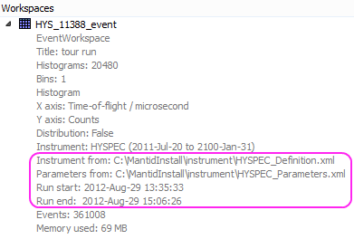
Workspace Details
Workspace details now display origin of instrument

Slide 15
Multi-Dataset Fitting
New interface for fitting across multiple data sets
Possible before but only from scripts
Missing some features of main fitting but is fully usable
Feedback (as always) is welcome!

Slide 16
Framework

Slide 17
Framework – Improvements
Instrument definitions
11 updated + new ones: TFXA, IMAT
Performance: Save/LoadNexusProcessed
Speedup for WorkspaceGroups: 138 s => 8 s
Algorithms:
~40 new ones
~100 have been improved/extended
Python command line interface / plotting…
!

Slide 18
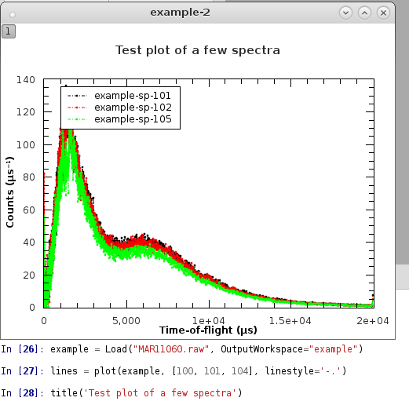
Python Command Line Interface
Traditional interface: improved error checking
New module with matplotlib-like interface:
Experimental – feedback!
Interface:
Pyplot/matlab, functional
Object-oriented
kwargs: linestyle=‘-.’, color=‘red’
Supports:
plotSpectrum / Bin / MD
Not to be confused:
Matplotlib also shipped

Slide 19
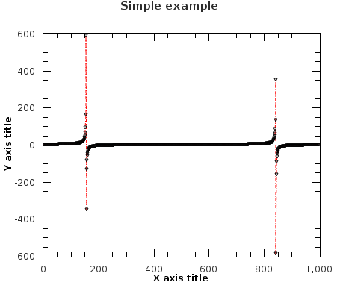
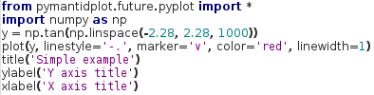
Python Command Line Interface
Experimental: from pymantidplot.future.pyplot import *
/ import pymantidplot.future.pyplot as plt
Harmonized interface:
plot(source=[{Workspace(s)}], tool={ToolName}, **kwargs)
ToolName: ‘plot_spectrum’, ‘plot_bin’, ‘plot_md’, …
Functional interface (pyplot / matlab):

Slide 20
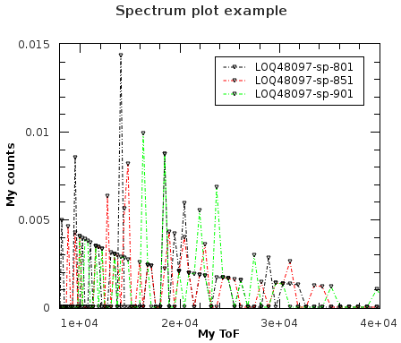
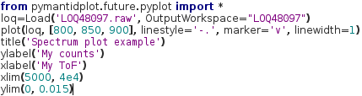
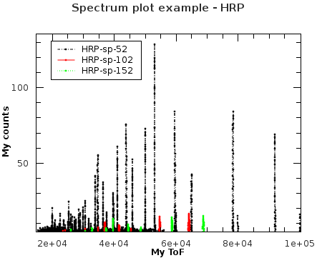
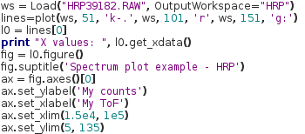
Python Command Line Interface
Plotting spectra:
Object-oriented interface (Figure, Axis, Line2D, etc.):

Slide 21
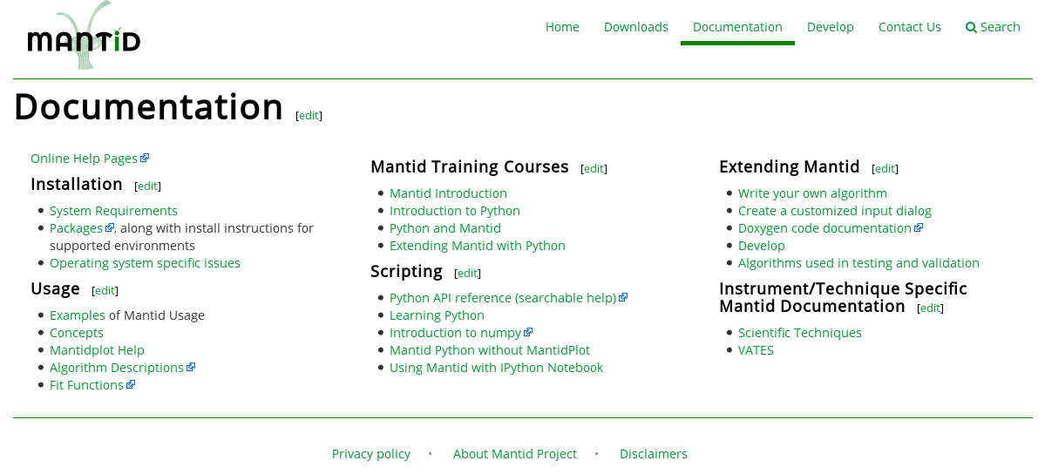
Python Command Line Interface
To learn how to use it:
help(pymantidplot.future.pyplot)
http://docs.mantidproject.org/nightly/api/python/index.html
Familiar interface, >90% like the Pyplot tutorial: http://matplotlib.org/users/pyplot_tutorial.html

Slide 22
Indirect Inelastic

Slide 23
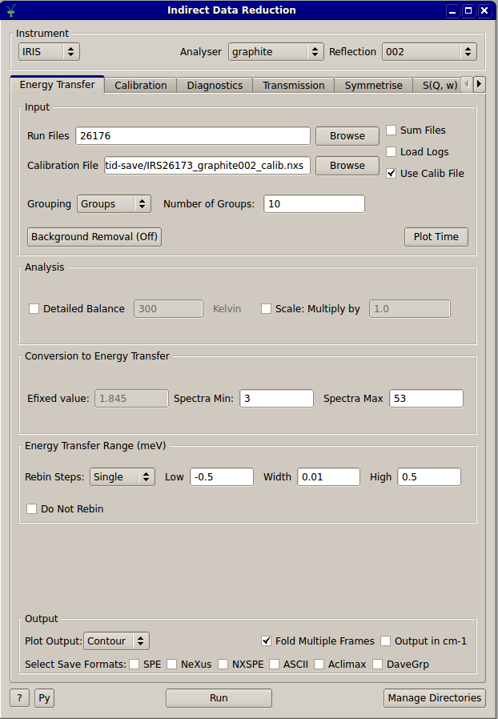
Updates to Interfaces
Name changes
Convert To Energy > Data Reduction
LoadAscii > Simulation and Tools
Notes:
23

Slide 24
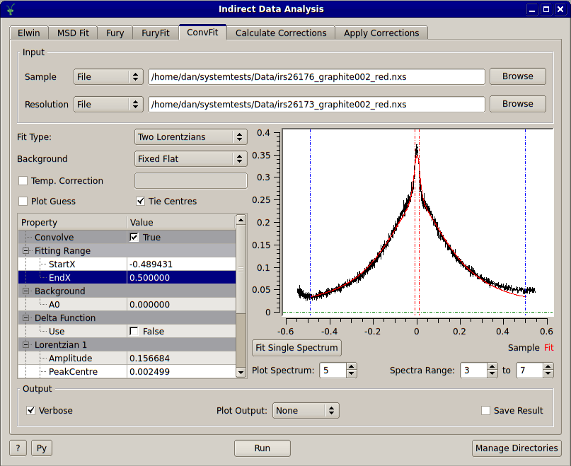
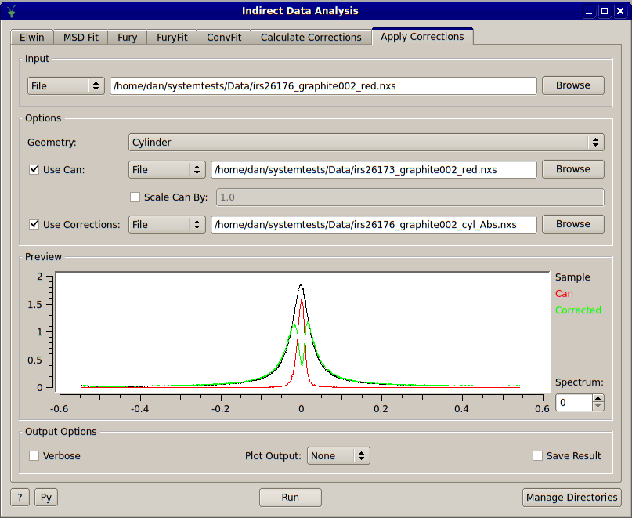
Updates to Interfaces
Preview plots and spectra selection
S(Q, w) support on IDR and Bayes
Notes:
24

Slide 25
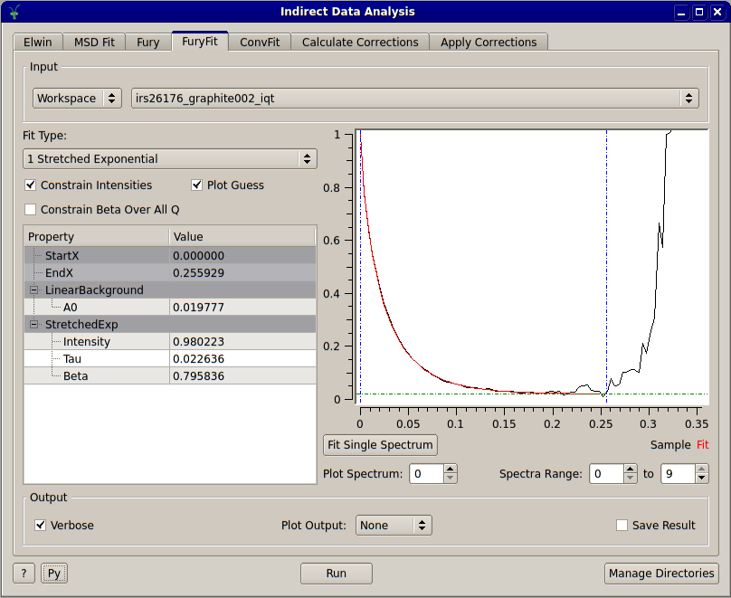
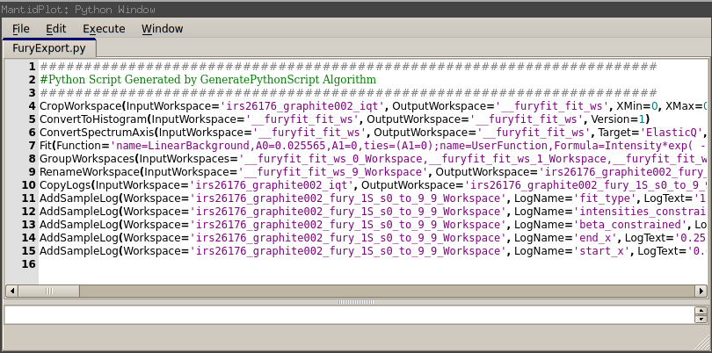
Updates to Interfaces
Python script export for IDR & IDA
Modify fitting, reduction, etc. parameters
Batch processing
Notes:
25

Slide 26
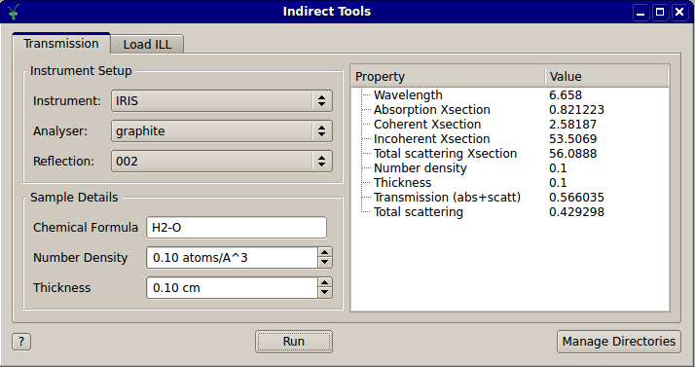
New Interfaces
Tools, currently contains Transmission calculator and LoadILL
Sample transmission calculator (IRIS, OSIRIS, BASIS & VISION)
Notes:
26

Slide 27
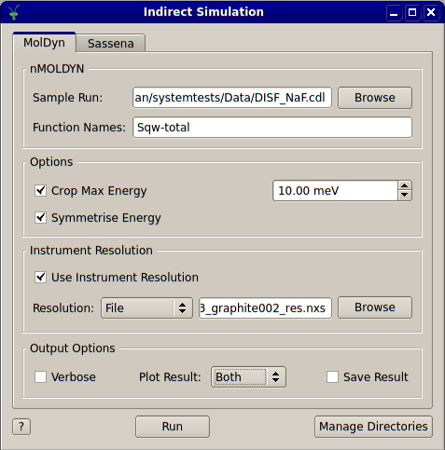
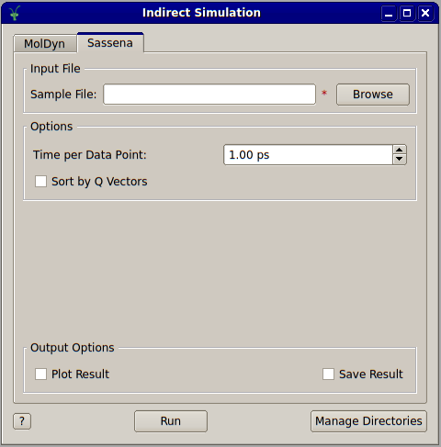
New Interfaces
Simulation, currently contains loaders for nMOLDYN and Sassena data
Notes:
27

Slide 28
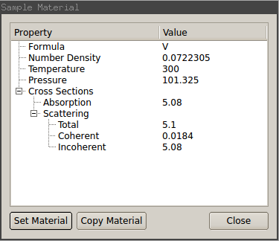
New Interfaces
Sample material UI
Show properties of sample material for a given workspace
Notes:
28

Slide 29
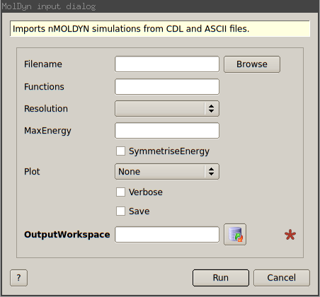
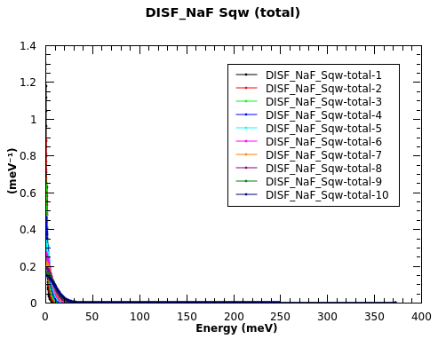
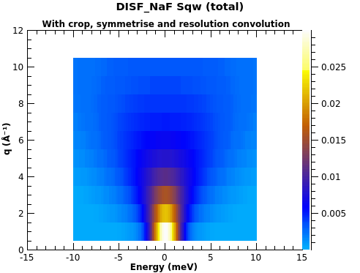
Simulation
New algorithm and updated UI for nMOLDYN
Energy crop and symmetrise
Convolve S(q, w) with instrument resolution
Notes:
29

Slide 30
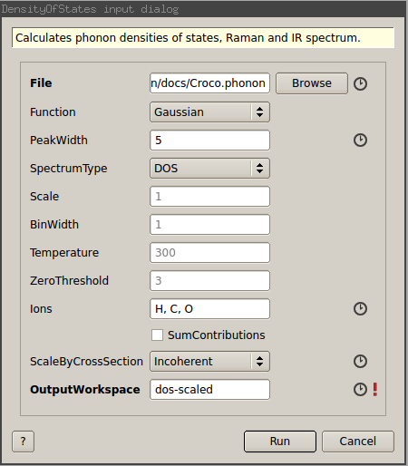
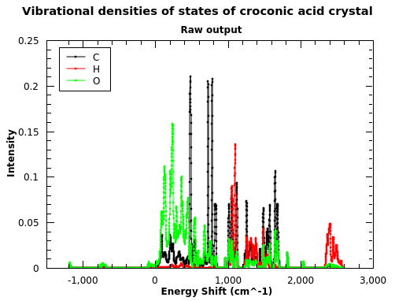
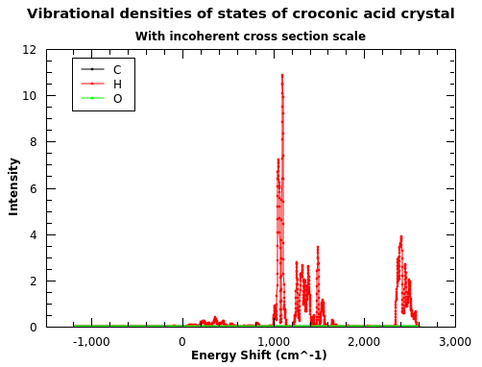
Simulation
Scattering cross section scaling in DensityOfStates
Notes:
30

Slide 31
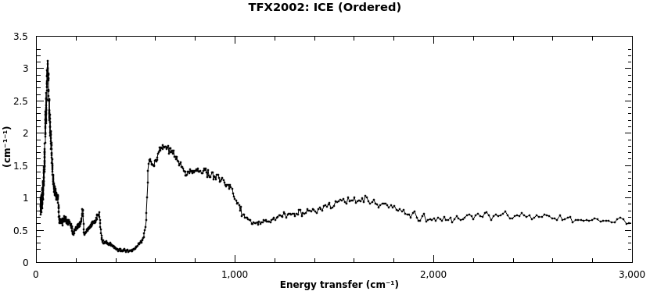
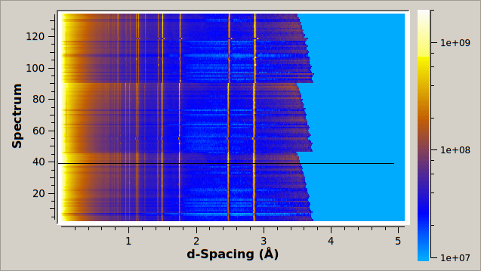
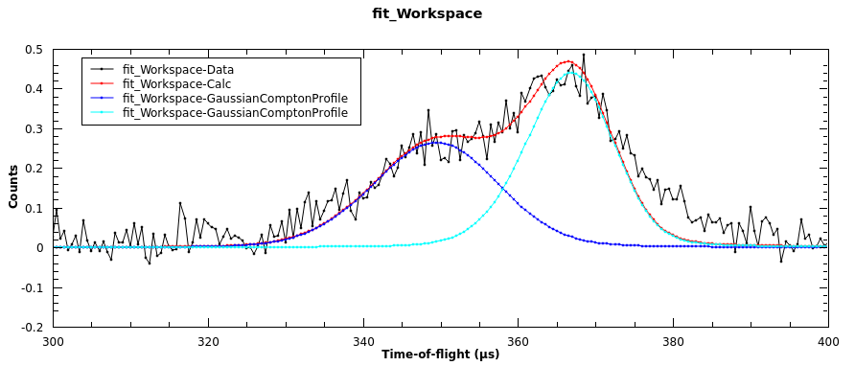
Instrument Support
Support added for TFXA and TOSCA-1 for energy transfer reductions
Old TFXA data now available on ISIS data archive and ICAT
Support for VESUVIO close to that of VMS routines
Notes:
31

Slide 32
Reflectometry

Slide 33
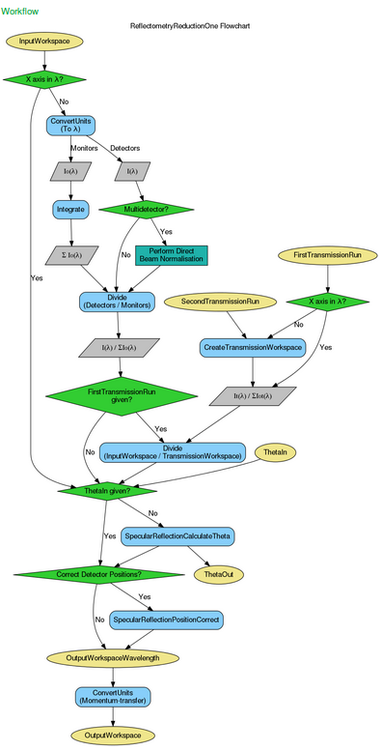
Algorithms
LoadNexus & SaveNexus have been optimised
ReflectometryReductionOne(Auto)
Support for workspaces in Wavelength
Polarization Correction
Workflow diagrams
CalculateResolution
SaveReflThreeColumnAscii

Slide 34
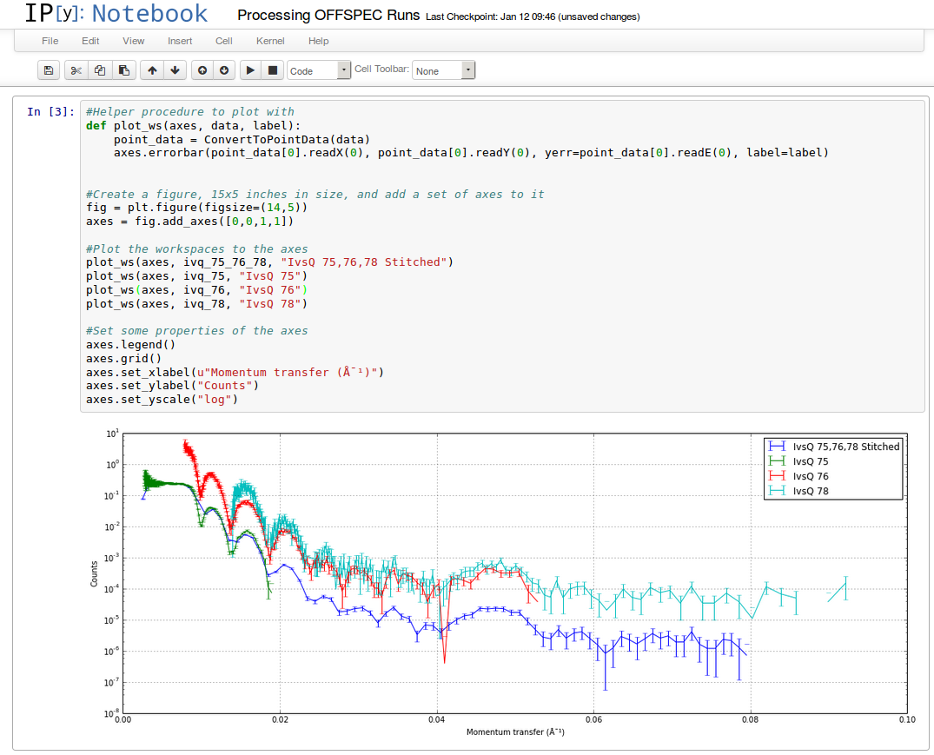
Experimental IPython Notebook Support

Slide 35
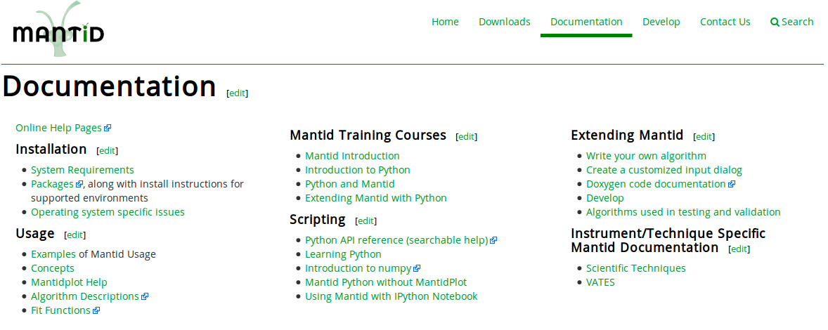
Experimental IPython Notebook Support
Using Mantid with IPython Notebook

Slide 36
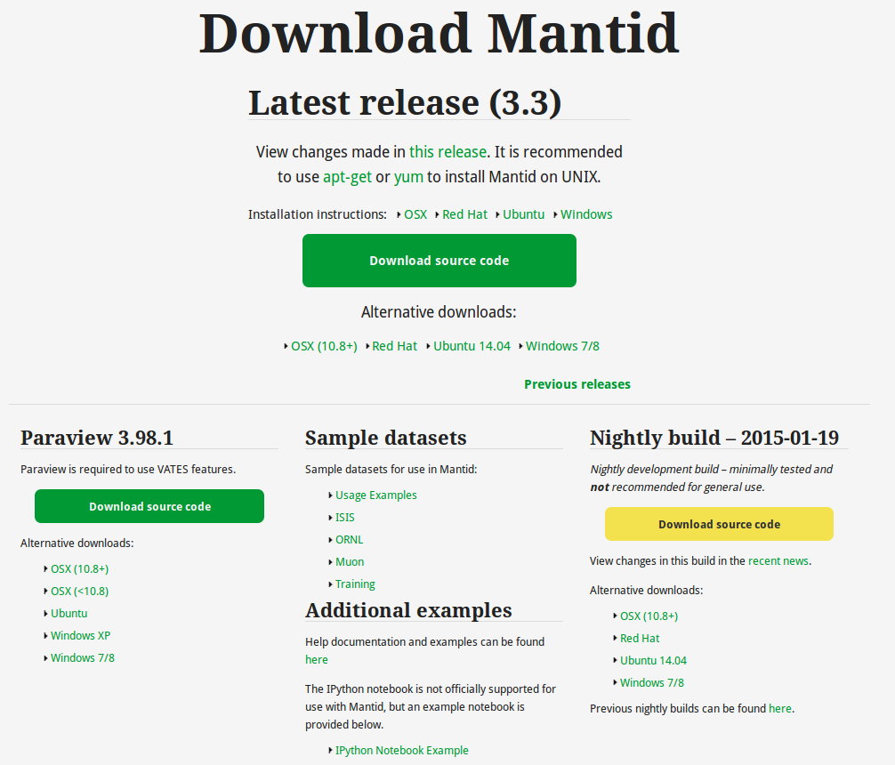
Experimental IPython Notebook Support
IPython Notebook Example

Slide 37
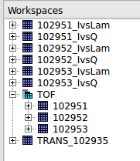
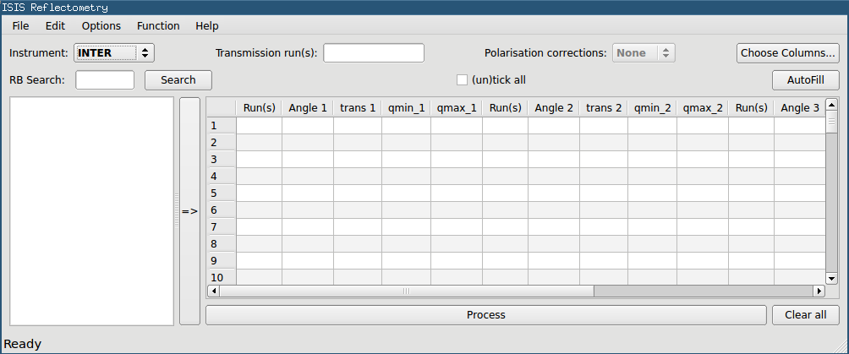
Reflectometry – ISIS Reduction Interface
POLREF support added
Plots are re-used
Time-of-Flight workspaces are kept
Improved test suite

Slide 38
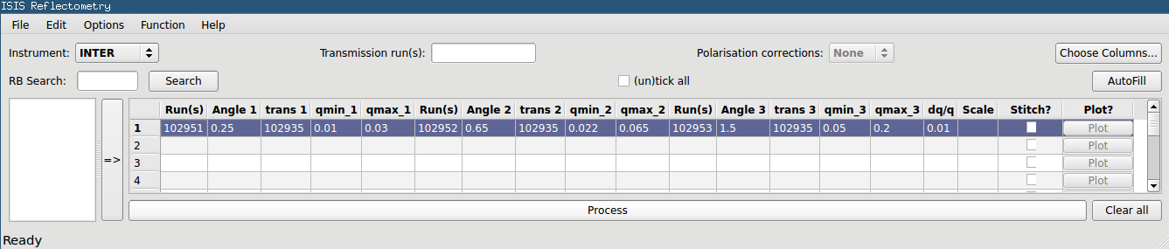
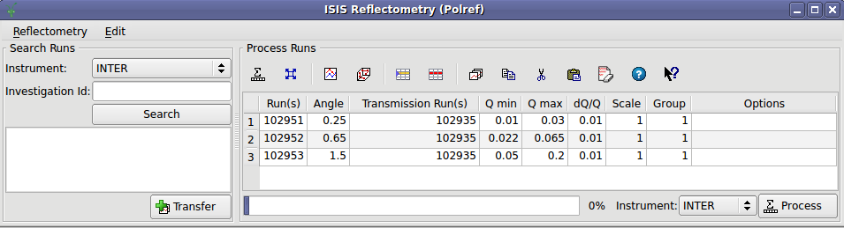
Reflectometry – New Reduction Interface
Existing UI
New UI

Slide 39
Reflectometry – New Reduction Interface
Demo

Slide 40
Diffraction

Slide 41
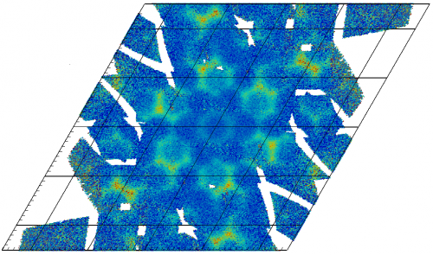
Normalisation
New Normalisation framework
Correctly accounts for statistical weights
MDNormSCD for elastic SC diffraction
Performance enhancements

Slide 42
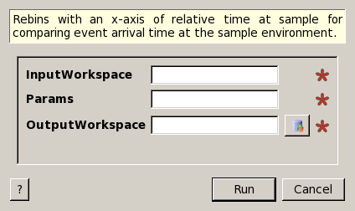
RebinByTimeAtSample
New Algorithm RebinByTimeAtSample
Works in the elastic case
Determines absolute event times at the sample, and rebins to a histogram form.
Aid and comparison for event filtering by fast logs.
Shared codebase with RebinByPulseTime

Slide 43
Point Groups
Point groups and symmetry classes have been added as core concepts in Mantid.
Minimal usage at the moment in the codebase
Exposed to python
Documentation with usage examples available here
http://docs.mantidproject.org/nightly/concepts/Point_groups.html
Contribution to Mantid from the PSI

Slide 44
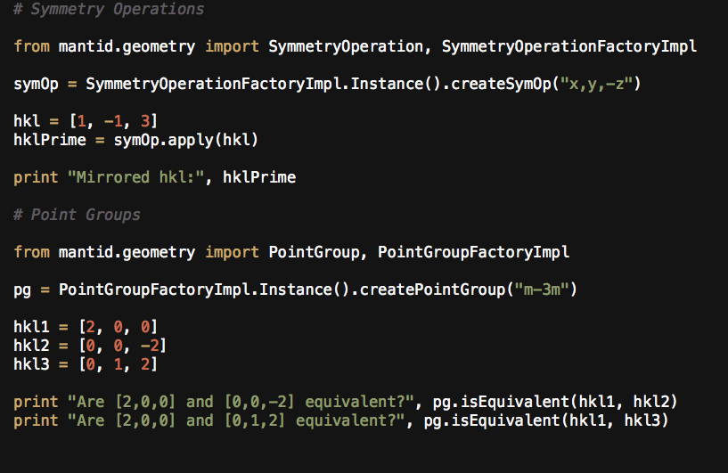
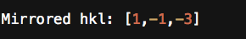
Symmetry Operations
Output:

Slide 45
Point Groups
Output:

Slide 46
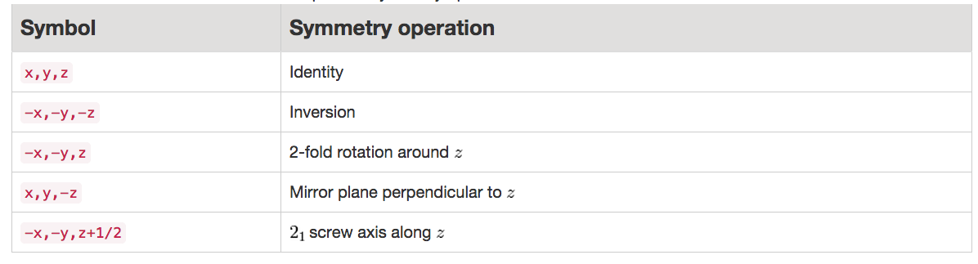


Slide 47
Fixes and Improvements
SaveLaueNorm new peak format
Connected Component Analysis engine fixed
Issue with integrated region off detector edge fixed
OrientedLattices exposes qFromHKL and hklFromQ
V3D gives direction angles, also via python
Several key bugfixes around the VSI particularly view-switching.

Slide 48


Paraview SCD progress
Technique dependent initial view in VSI
Not quite ready for this release
More powerful in-situ rebinning
Faster representations at lower memory overhead
Faster slicing
Multi-window mode
A less confusing interface
http://www.mantidproject.org/VatesSimpleInterface_v2

Slide 49
SANS

Slide 50





SANS
http://www.mantidproject.org/ISIS_SANS
Q-resolution: TOFSANSResolutionByPixel
where

Slide 51
Muon

Slide 52




Muon
New algorithm: PhaseQuad
Input workspace
Input phase table/list
$$φ$$

Slide 53


Muon
New algorithm: PhaseQuad
Output workspace:
2 spectra
Real + Imaginary
Lab-frame
Input phase table/list

Slide 54
Autoreduction

Slide 55

What is it?
A system for running user provided* reduction scripts as soon as data becomes available from the beamline.
Can work with Mantid.
A web application to manage and monitor automatic reduction jobs.
* Added by Instrument Scientist

Slide 56

Features
Automatically run user provided scripts as early as possible.
Provide different scripts for different runs / experiments.
Modify script variables through the web interface.

Slide 57
Features
See an overview of reduction jobs from the web application.

Slide 58

Features
View details of each run.

Slide 59

Features
Re-run reduction jobs with new script variables (or a new script).

Slide 60


Features
Access it from many devices.

Slide 61
Demo (Hopefully)

Slide 62
Contact
Marcus Noble
marcus.noble@stfc.ac.uk
Lottie Greenwood
lottie.greenwood@stfc.ac.uk
System Problems / Help
isisdata@stfc.ac.uk

Slide 63
Direct Inelastic

Slide 64
Direct Inelastic Single reduction script for all instruments and usage
Verify settings
Reprocess data
New user logged into Linux services
User takes script with him
Sysadmin sets it up into startup script
Users sets datasearch path
Set up, run locally,
verify, place to right location
Single reduction script
Instrument
scientist
IS defines the result
IS places it to autoreduce
Verify Old results
Run single file
Local scripts testing folder+ old sample result
Autoreduction

Slide 65
Direct Inelastic: Bugfixes and efficiency improvements
MAIN CHANGES:
Direct inelastic script properties are fully defined by InstrumentParameters.xml file (you can not add or modify property not defined in this file)
Works with autoreduction too.
Correct parameter file while processing old experimental results
Consistent data loading (Source-file and Source-workspace behave the same way)
3-fold increase in unit/system test coverage.
Later rebinning and internal multirep mode (in progres)

Slide 66
Next Release

Slide 67
Release v3.4
Planned Release Date: Friday 1st May 2015
Mantid Roadmap
http://trac.mantidproject.org/mantid/roadmap

Slide 68

Thank you

